Slide 1








CMSC204
Az
V(StateGraph) = {Oregon, Alaska, Texas, Hawaii, Vermont, NewYork, California}
E(StateGraph) = {(Alaska, Oregon), (Hawaii, Alaska), (Hawaii, Texas), (Texas, Hawaii), (Hawaii, California), (Hawaii, New York), (Texas, Vermont), (Vermont, California), (Vermont, Alaska)}
1. Draw the StateGraph
Oregon
New York
California
Alaska
Texas
Vermont
Hawaii
no
Yes
Texas

Slide 2
a. Show the adjacency matrix that would describe the edges in the graph. Store the vertices in alphabetical order
States
Oregon Alaska Texas Hawaii Vermont NY Cali
Oregon
Alaska
Texas
Hawaii
Vermont
New York California
X | ---- | --- | --- | --- | --- | ---
1 | X | --- | --- | --- | -- | --
--- | --- | X | 1 | 1 | --- | ---
--- | 1 | 1 | X | --- | 1 | 1
--- | 1 | --- | --- | X | -- | 1
-- | --- | --- | --- | --- | X | ---
--- | ---- | ---- | ---- | ---- | --- | X
3. b. Show the adjacency lists
that would describe the edges in the graph
Oregon
Alaska
Texas
Hawaii
Vermont
New York California
Oregon
Hawaii --> Vermont
Texas → Alaska →California → NY
Alaska → California

Slide 3
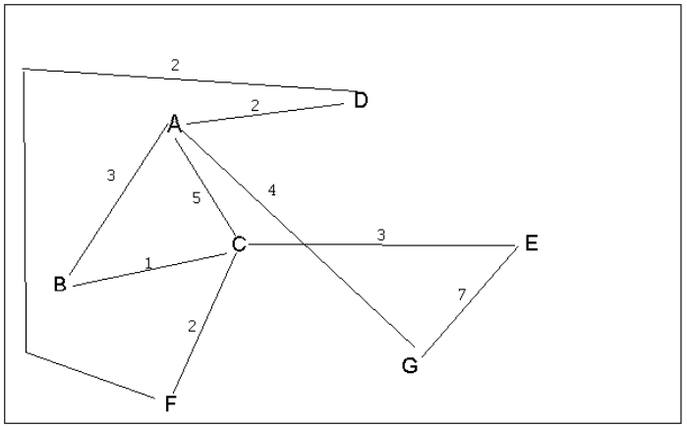


4 a. Which of the following lists the graph nodes in depth first order beginning with E?
A) E, G, F, C, D, B, A
B) G, A, E, C, B, F, D
C) E, G, A, D, F, C, B
D) E, C, F, B, A, D, G
4 b. Which of the following lists the graph nodes in breadth first order beginning at F?
A) F, C, D, A, B, E, G
B) F, D, C, A, B, C, G
C) F, C, D, B, G, A, E
D) a, b, and c are all breadth first traversals

Slide 4
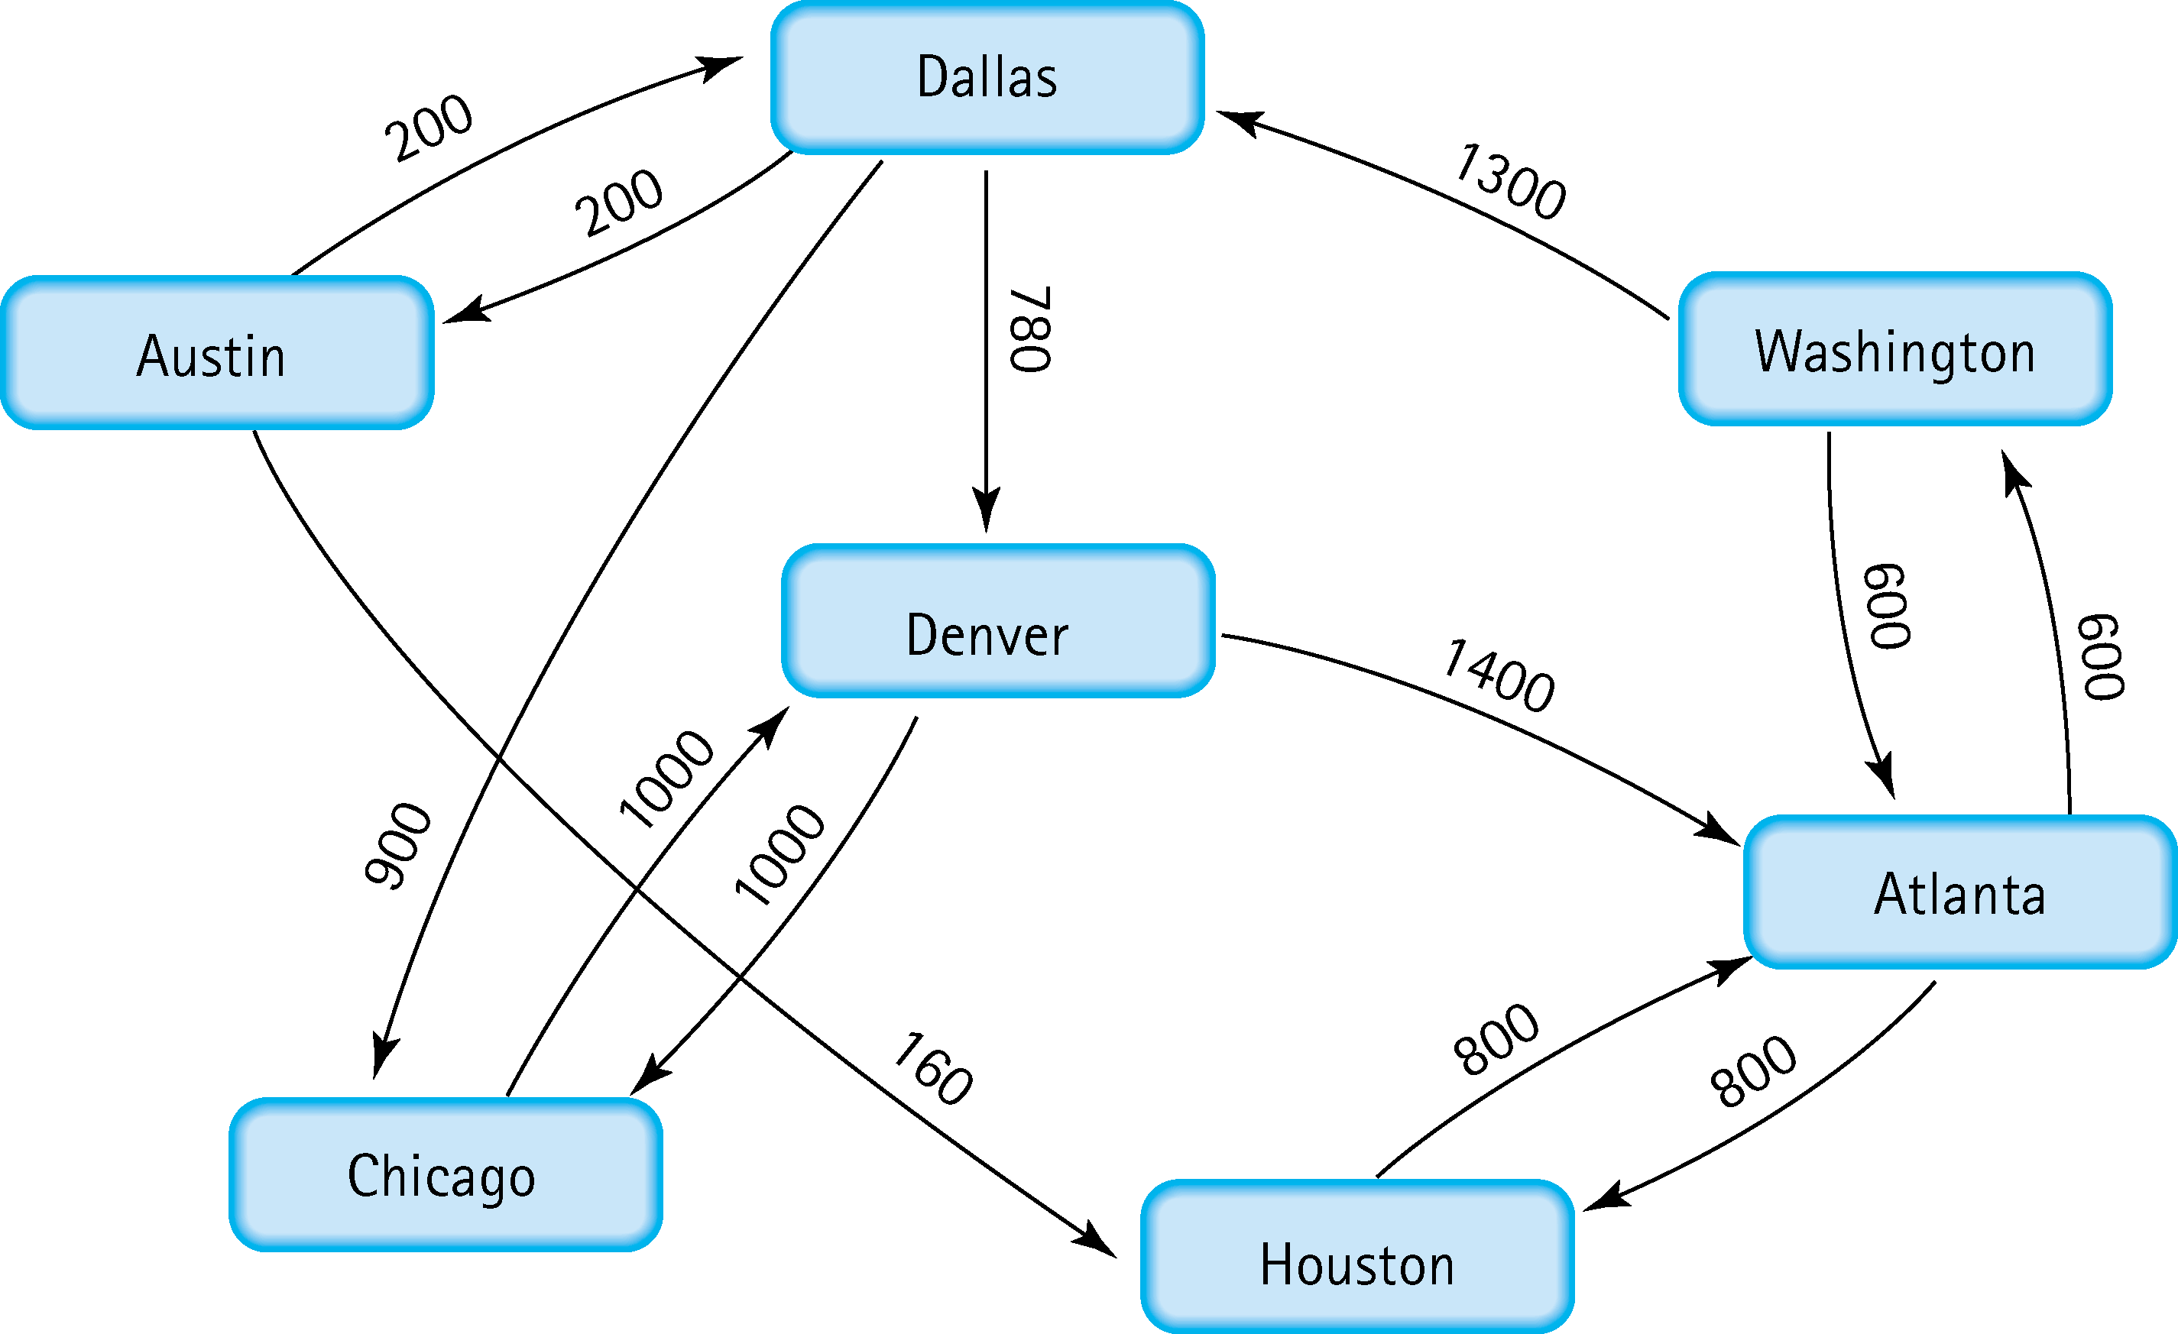
5. Find the shortest distance from Atlanta to every other city
Atlanta > Washington: 600
Atlanta > Houston: 800
Atlanta >Dallas : 600+1300=1900
Atlanta > Austin: Dallas+200=2100
Atlanta > Denver: Dallas + 780= 2680
Atlanta > Chicago : Dallas + 900= 2800

Slide 5
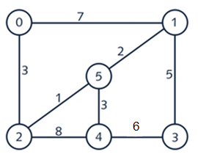



6. Find the minimal spanning tree using Prim’s algorithm. Use
0 as the source vertex . Show the steps.

Slide 6




7. Find the minimal spanning tree using Kruskal’s algorithm.
Show the weights in order and the steps.

Slide 7
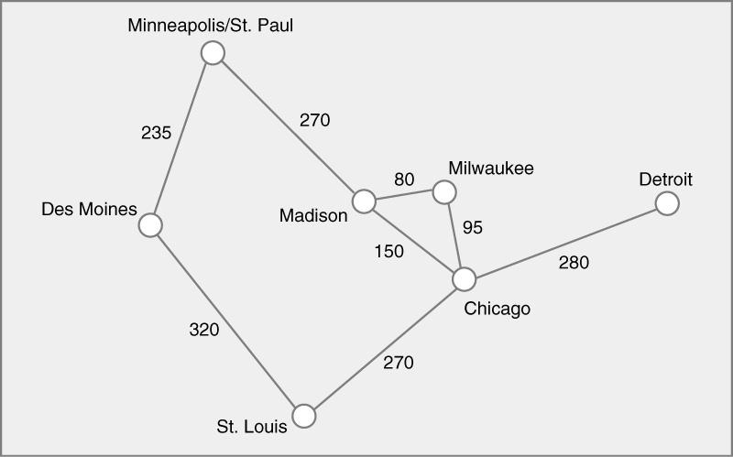

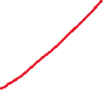


8. Find the minimal spanning tree using the algorithm you prefer. Use
Minneapolis/St. Paul as the source vertex
Primi’s algorithm

Slide 8
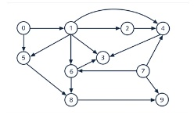
0,7,5,1,9,6,4,8,2,3
9. List the nodes of the graph in a breadth first topological ordering. Show the
steps using arrays predCount, topologicalOrder and a queue
0
1
2
3
4
5
6
7
8
9
2 | 4 | 1 | 0 | 0 | 1 | 1 | 3 | 1 | 0
0
0
0
2
3
4
5
6
7
8
9
2 | 4 | 1 | 0 | 0 | 1 | 1 | 3 | 1 | 0
0
7 | 5
0
1
2
3
4
5
6
7
8
9
2 | 4 | 1 | 0 | 0 | 1 | 1 | 3 | 1 | 0
0 | 7
5 | 1

Slide 9
0,7,5,1,9,6,4,8,2,3
9. List the nodes of the graph in a breadth first topological ordering. Show the
steps using arrays predCount, topologicalOrder and a queue
0
1
2
3
4
5
6
7
8
9
0 | 4 | 1 | 0 | 0 | 1 | 1 | 3 | 1 | 0
0 | 7 | 5 | 1
9 | 4 | 6
0
1
2
3
4
5
6
7
8
9
0 | 4 | 1 | 0 | 0 | 1 | 1 | 0 | 1 | 0
0 | 7 | 5 | 1 | 9 | 4 | 6
8
0
1
2
3
4
5
6
7
8
9
0 | 4 | 1 | 0 | 0 | 1 | 1 | 0 | 1 | 0
0 | 7 | 5 | 1 | 9 | 4 | 6 | 8
5 | 6 | 3 | 2 | 4
0
1
2
3
4
5
6
7
8
9
0 | 0 | 0 | 0 | 0 | 0 | 0 | 0 | 0 | 0
0 | 7 | 5 | 1 | 9 | 4 | 6 | 8 | 2 | 3

Slide 10
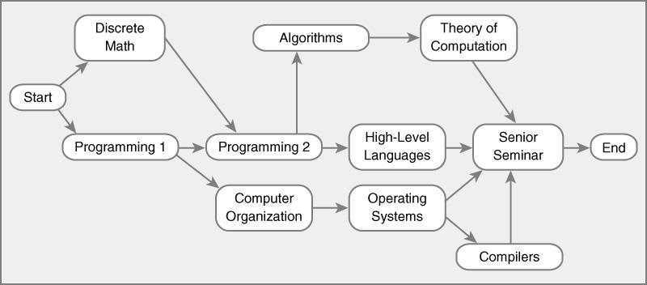
10. List the nodes of the graph in a breadth first topological ordering.
Start
Programing 1
Discrete Math
Programing 2
Computer org
Algorithms
High lvl lang
Operating System*
Theory of computation
Senior Seminar
Compilers
End

